Slide 1

IoC and DI with Ninject
5 – Using Ninject

Slide 2
Overview
What is Ninject?
Setting up the Container
Using the container
Managing Lifecycle
Other features

Slide 3
What is Ninject?
Newer
Simple
Extensible

Slide 4
Ninject Constructs
StandardKernel
.Bind.To
.Get
Named instances
Lifecycle management
Factory methods
Events
Modules

Slide 5
Kernels
This is the container for the application
One default implementation: StandarKernel

Slide 6
Registrations
Performed with .Bind<>()
Fluent syntax
.To<>() specifies target
Can use names

Slide 7
Resolution
.Get<>()

Slide 8
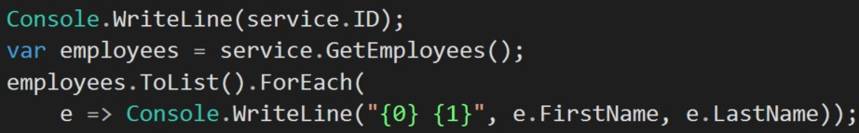
Use the object

Slide 9
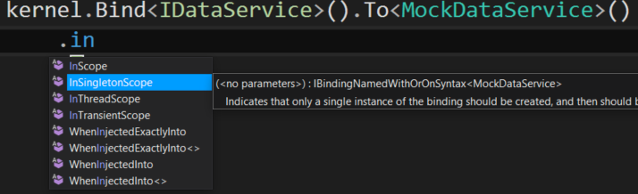
Lifetime Scopes
Singleton
Thread
Request
Custom

Slide 10
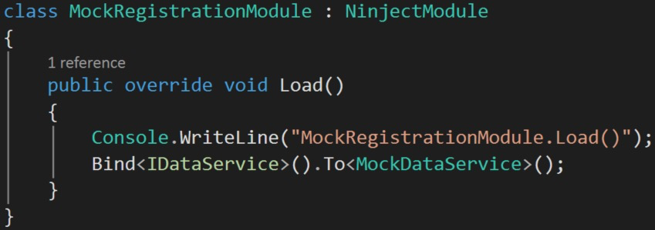
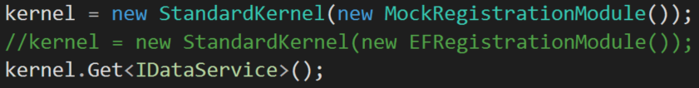
Modules
Places to load configurations
Helps to control large/mass registrations of objects

Slide 11
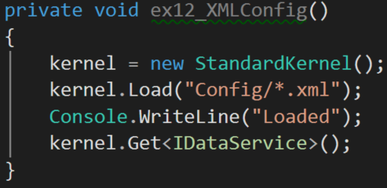
XML Configuration
.Load()

Slide 12
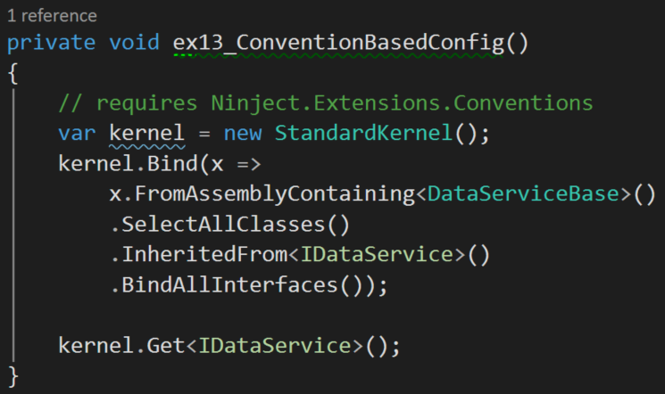
Convention over configuration
Add reference to the conventions extension
Ninject.Extensions.Conventions
Fluent API

Slide 13
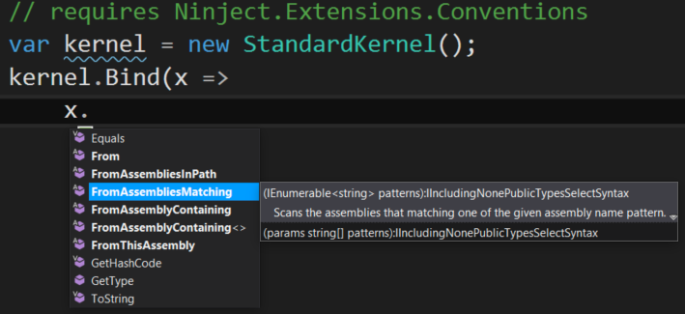
Selecting assemblies

Slide 14
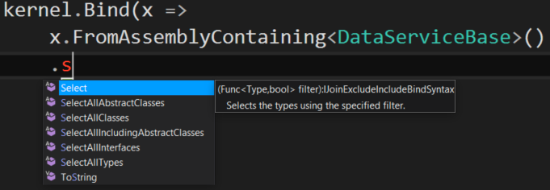
Selecting Classes

Slide 15
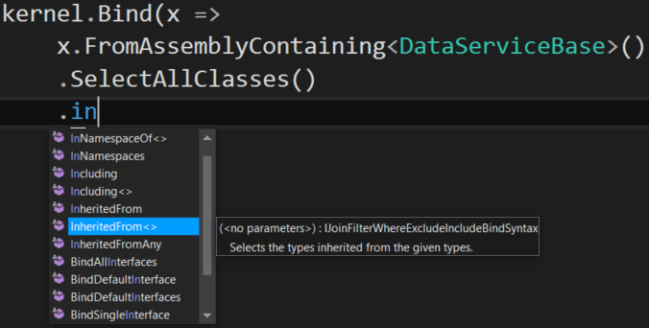
InheritedFrom

Slide 16
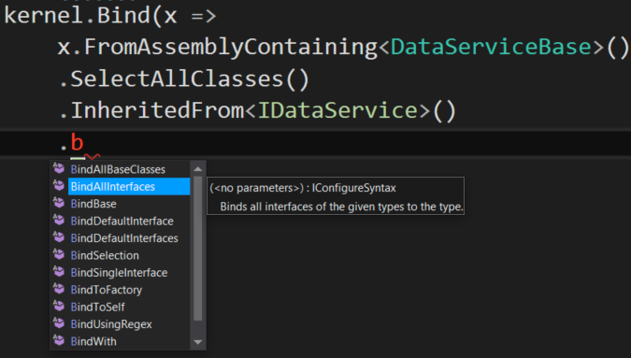
Selecting service types
BindAllInterfaces
BindBase
…

Slide 17
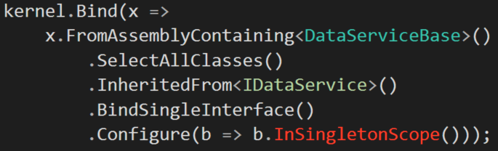
Configure

Slide 18
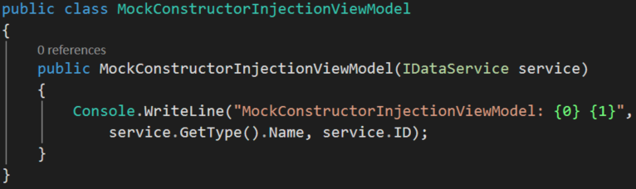
Constructor injection
Preferred model
How to disambiguate constructors

Slide 19
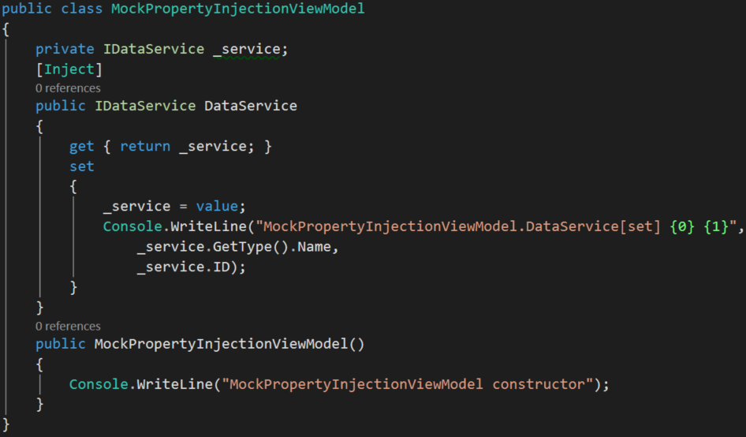
Property Injection
Initialized after constructor executes
Use the [Inject] attribute

Slide 20
IInitializable
Support this interface and Ninject will call the Initialize() method after all injections have been completed
Useful when using property injection to know when all properties are injected

Slide 21
Contextual Binding
Using names
Target-based
Constraint attributes
Generic helpers
Context-based

Slide 22
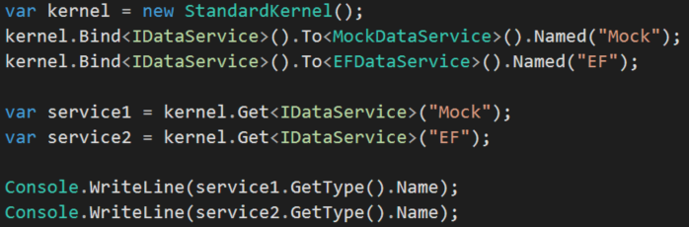
Name based resolution
Partition into names
Easy to substitute names from configurations

Slide 23
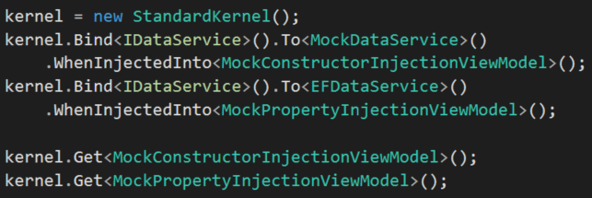
Target-based injections
Specifies what gets injected into what by type

Slide 24
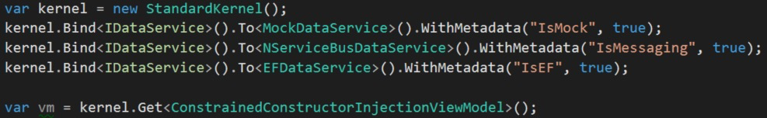
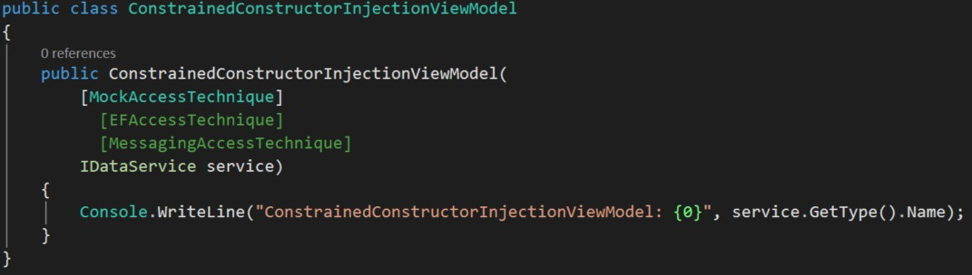
Constraint-based binding
Uses ConstraintAttribute

Slide 25
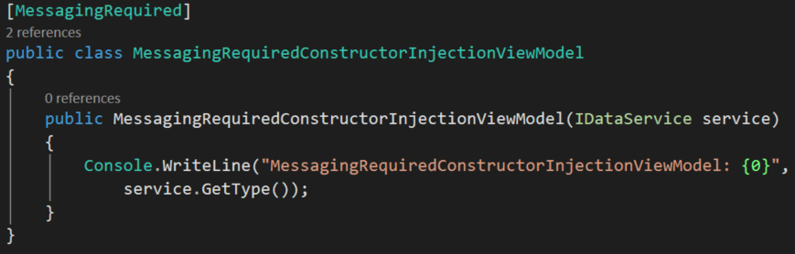
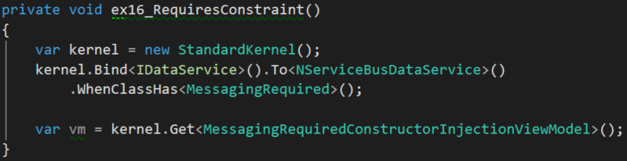
Generic Helpers
Generic attribute based

Slide 26
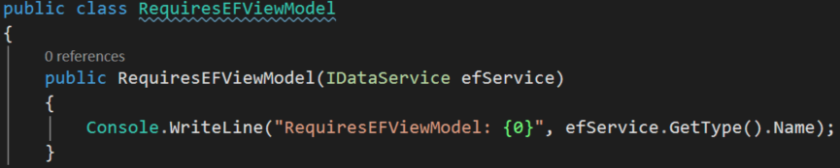
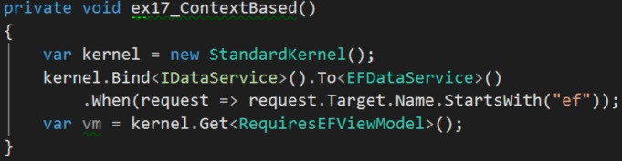
Context-based

Slide 27
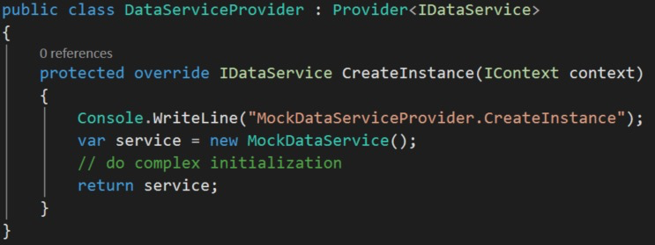
Custom Providers
Specialized factory classes
Used for various reasons including interception
Default is StandardProvider

Slide 28
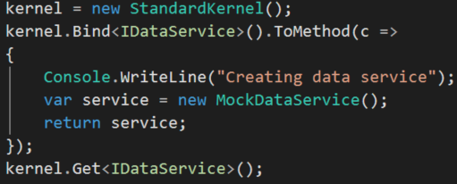
Factory methods

Slide 29
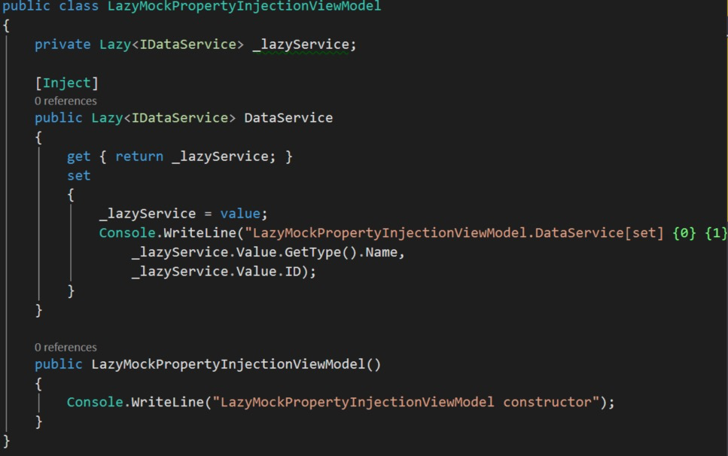
Lazy instantiation
Defers injection until a property is utilized
Requires Ninject.Extensions.Factory

Slide 30
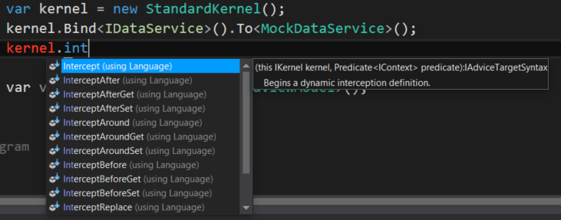
Interception
Include Ninject.Extensions.Interception, and
Ninject.Extensions.Interception.[Linfu|DynamicProxy]

Slide 31
Summary
Ninject is a great IoC container
Very flexible in options for creating objects
Interception framework is great for AoP

Slide 32
Demo
Walkthrough of the concepts

Slide 33
Lab
Create kernel
Register object
Change lifetime to singleton

